Slide 1

Junior Project Proposal
CSE 299
Group no. 7
Group Members
Akash Lanard | 172 1271 0 42
Ekhfa Hossain | 172 1625 0 42
Sudipta Mandal | 172 1489 0 42
Faculty Advisor
Intisar Tahmid Naheen (ITN) North South University

Slide 2

DocTalk : A Platform to get Doctor’s Advice
Table Of Content
Abstract | Page 1
Introduction, Objective, Scope | Page 2
Methodology, Approach, Constraints | Page 3
Software, Budget, Time Plan | Page 4
Time Distribution (Gantt Chart) | Page 5
Expected Outcomes | Page 6
Abstract
The DocTalk is an android app to help the users for easy access consultation from a doctor. Especially during the COVID-19 pandemic, its hard to get a face to face consultation and advice for regular medical urgency.
DocTalk is a platform to connect the user and doctor in a same place. Also DocTalk will help the user to get the prescribed medicine from the best available online store.
Moreover, it will show appropriate online resources according to the doctor’s prescription.
Page 1

Slide 3
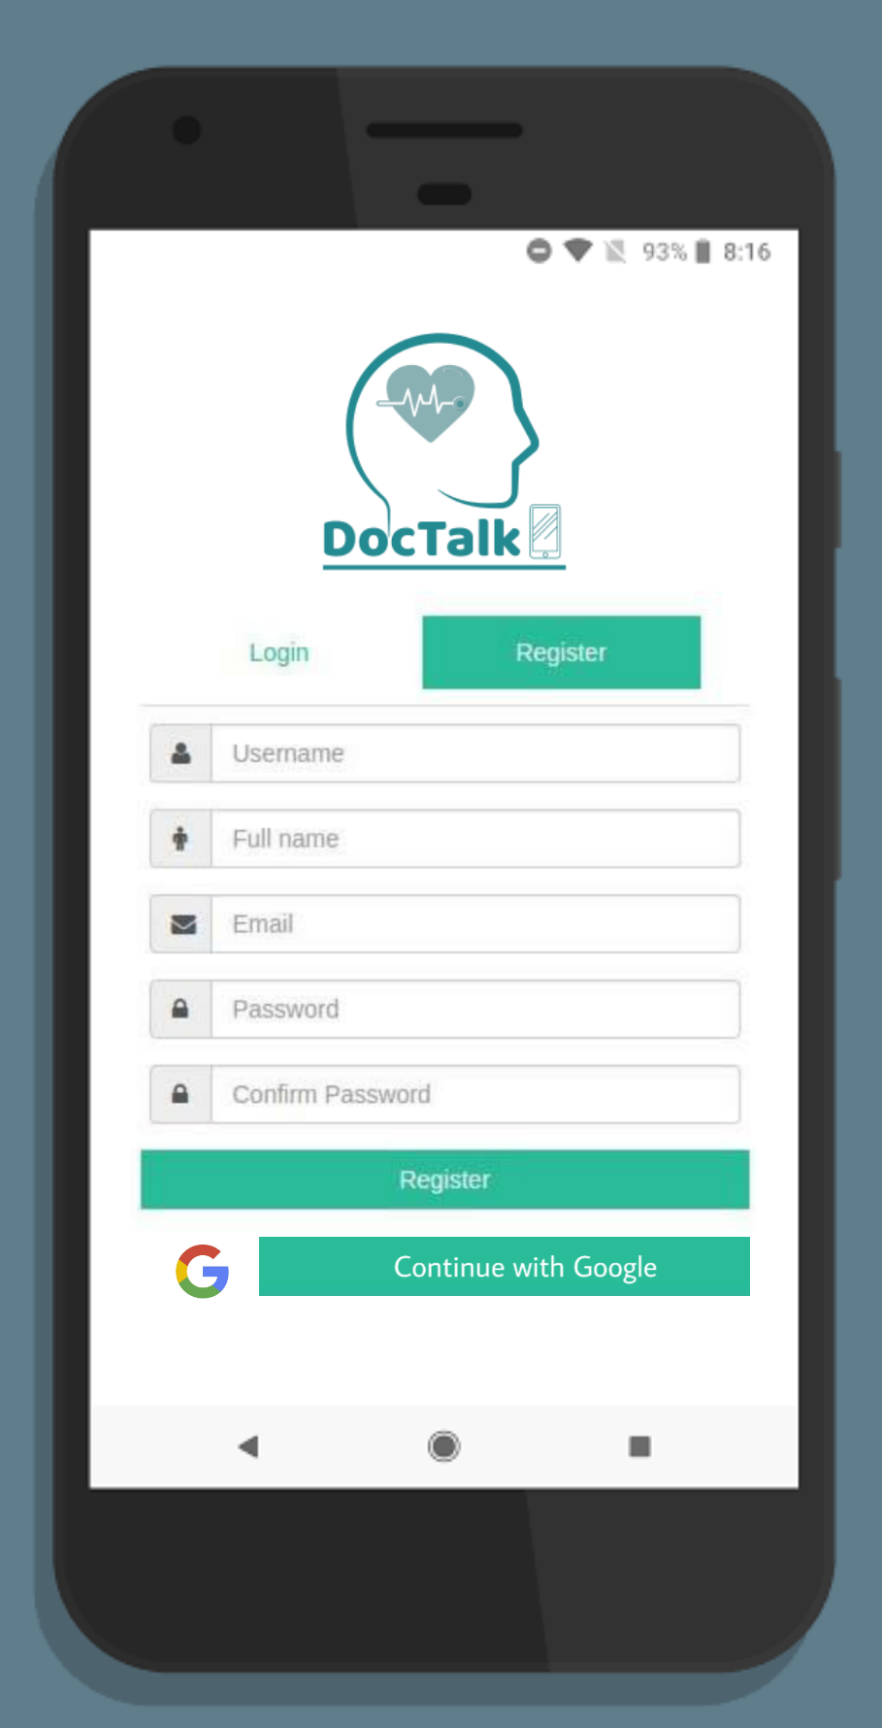
Introduction and Background
This is an interactive app to connect general user to certified doctor for medical advice. During pandemic like COVID-19 this app can help to get appropriate advice in a very easy way. Also, this app can show the available way to get prescribed medicine automatically.
Objective
Get consultation from doctor
Save medical history and information
Get prescription
Get the prescribed medicine from online sources
Get instruction and appropriate videos of prescribed exercise
Scope
This is an app for medical and health services. It can be used very efficiently during any pandemic situation as well as for general life uses.
There are a lots of potential for this field in Bangladesh.
Page 2

Slide 4


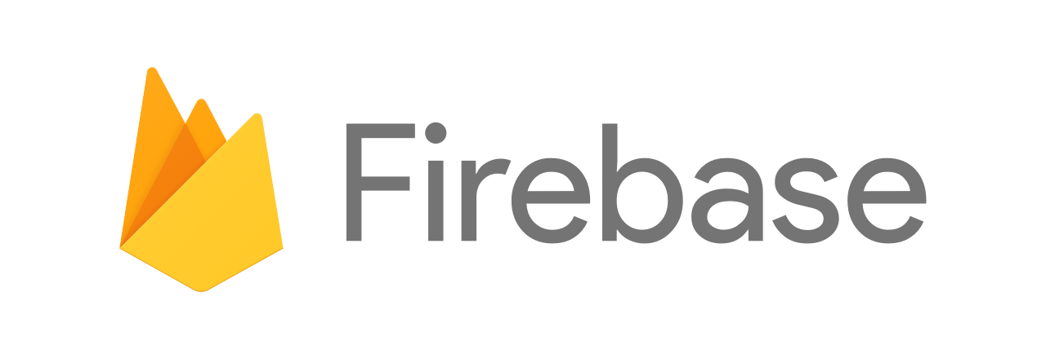
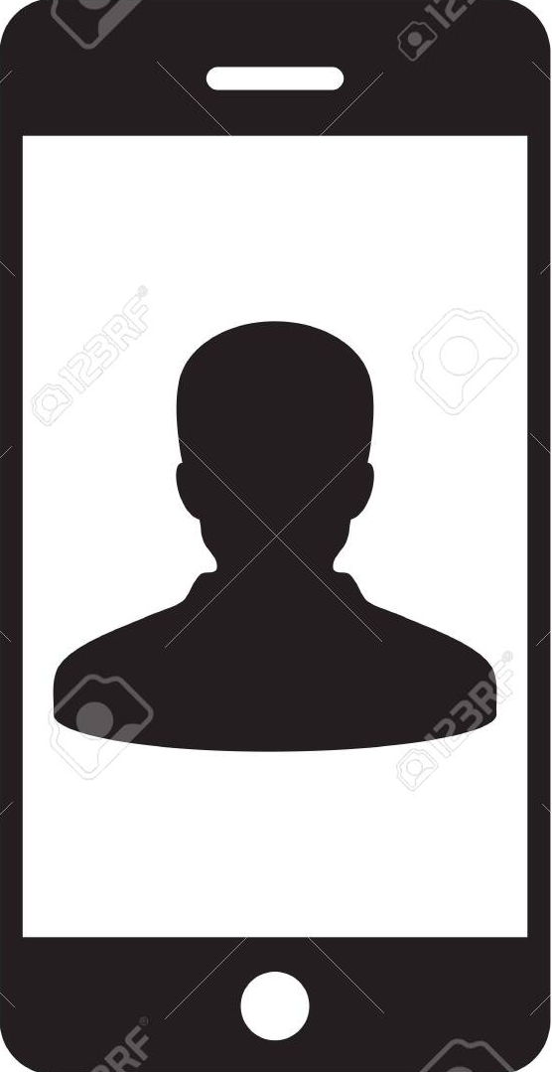
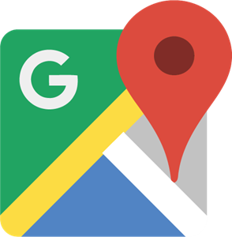
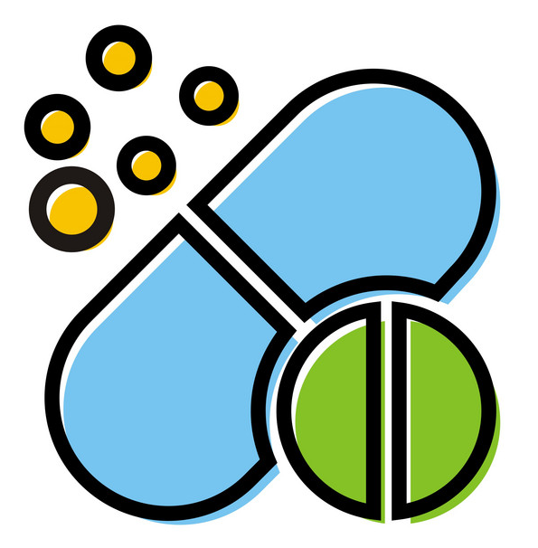
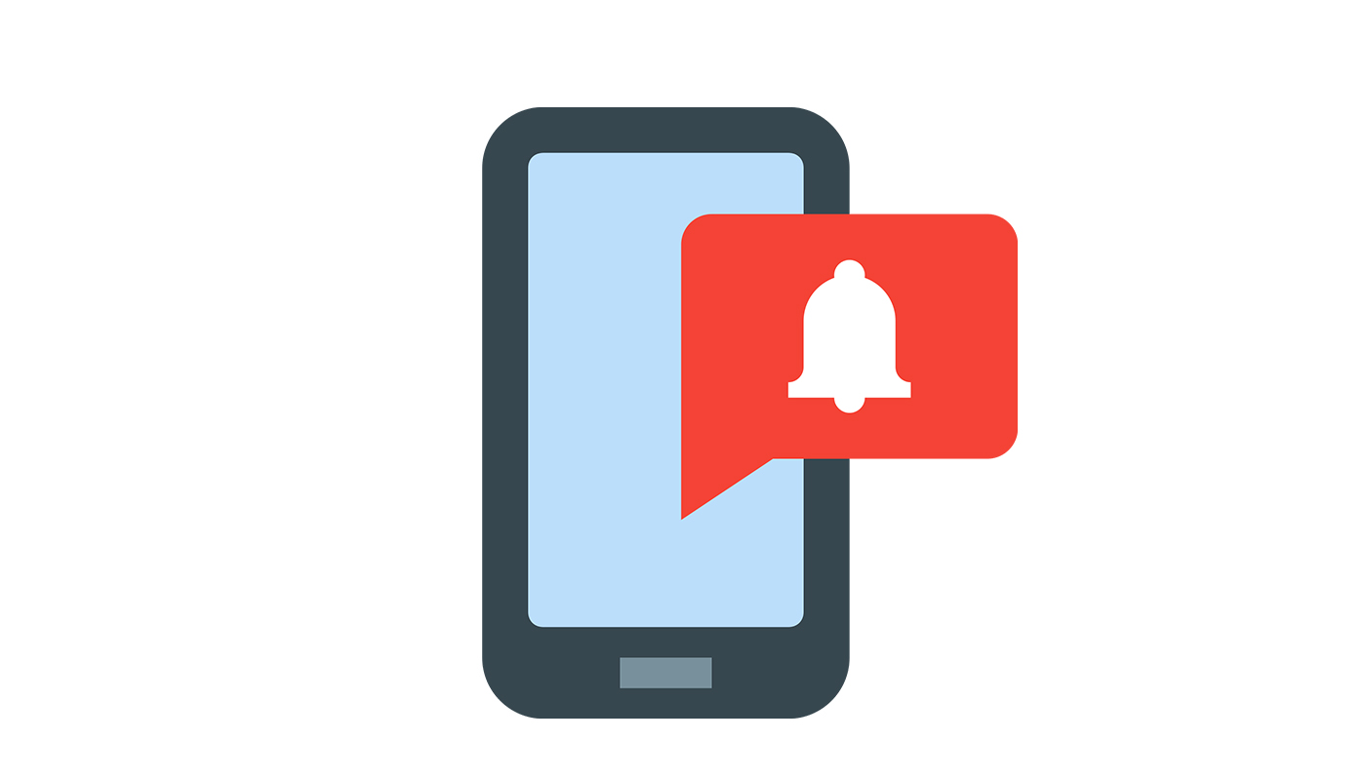

Methodology and Approach
Android Studio: Since project is an Android app
Firebase: For online database of the project
Vision API: To get text from the prescription
Drug Search via Gmap: See available online source
YouTube API: To get appropriate videos to suggest
Firebase Notification: To apply push notification
Constraint and Limitations
Several learning constraints
Short time limit, only 3 months
Implementing APIs and database connect
Challenges
Learning several topics in a short period of time
Implementing everything and complete the project within the time limit
Organizing the group work over the internet for current pandemic situation
Design Approach
Page 3

Slide 5
Time Plan
Software and Budget
Will use Android Studio to implement the project
Firebase will be used for database
PicsArt and Adobe illustrator for logo design
As long as our project doesn’t require more space for database, there no money needed for the project.
We will use the free version of all APIs (Google Map, Cloud vision, Push Notification etc.)
Task Partitions | Description
Task 01 | Learning Phase 1 (Git, Android Studio)
Task 02 | Learning Phase 2 (Android Studio, Firebase)
Task 03 | User registration (Manual, via Gmail)
Task 04 | Creating Database (Firebase)
Task 05 | Connecting Database, Upload image service
Task 06 | Implementing Vision API, Camera App
Task 07 | Text Recognition, Putting Drug store information
Task 08 | Implementing Google Map
Task 09 | Search by the recognized text
Task 10 | Connect YouTube API
Task 11 | Finalizing User Interface
Task 12 | Unit Testing and Bug fixing
Page 4

Slide 6
Time Distribution
July 12 | July 19 | July 26 | Aug 2 | Aug 9 | Aug 16 | Aug 23 | Aug 30 | Sep 6 | Sep 13 | Sep 20 | Sep 27
Week 1 | Week 2 | Week 3 | Week 4 | Week 5 | Week 6 | Week 7 | Week 8 | Week 9 | Week 10 | Week 11 | Week 12
Task 01
Task 02
Task 03
Task 04
Task 05
Task 06
Task 07
Task 08
Task 09
Task 10
Task 11
Task 12
Learning Phase I
Learning Phase II
User Registration
Creating Database
Connecting DB
Cloud Vision API
Drug Store Information
Google map API
Search
YouTube
User Interface
Finalizing
Figure: Gantt Chart
Page 5

Slide 7

Expected Outcomes
The project is entirely to help general people to get medical advice on their smartphone.
The program is expected to lighten up the burden of workload to get general information from a doctor. Also it is expected the project will help people to get appropriate medicine from the best way possible.
Finally, during this pandemic it is expected the project will help out on our general way of life.
Page 6

